Slide 1
The Predicate Calculus

Slide 2
MEMBERS
Nguyễn Nhựt Tân ITITIU16125
Vũ Nhật Thanh ITITIU16054
Hồ Đắc Tín ITITIU16058
Đỗ Anh Lâm ITITIU16037

Slide 3
outline
Introduction
The Propositional Calculus
The Predicate Calculus
Using Inference Rules to Produce Predicate Calculus Expressions
Application: A Logic-Based Financial Advisor
Epilogue and References

Slide 4
Introduction

Slide 5
Instructions
A representation language for AI
Well-defined formal semantics
Predicate calculus and complete inference rules
Using predicate calculus to implement a knowledge base for financial investment advice

Slide 6
The Propositional Calculus

Slide 7
Propositional Calculus Symbol
The symbols of propositional calculus are the propositional symbols: P,Q,R,S,…
Truth symbols: True ,false
Connectives: ∧ → ∨ ¬ ≡

Slide 8
Propositional Calculus Sentences
Every propositional symbol and truth symbol is a sentence.
Ex: P, Q, R, true are sentences.
The negation of sentence is a sentences.
Ex: ¬P and ¬false are sentences.
The conjunction, and, of two sentences is a sentence.
Ex: P∧¬P is a sentence.
The disjunction, or of two sentences is a sentence
Ex: P∨¬P is a sentence.
The implication of one sentence from another is a sentence.
Ex: P→Q is a sentence.
The equivalence of two sentences is a sentence.
Ex: P∨Q≡R is a sentence.
Legal sentences are also called well-formed formulas (WFFs).

Slide 9
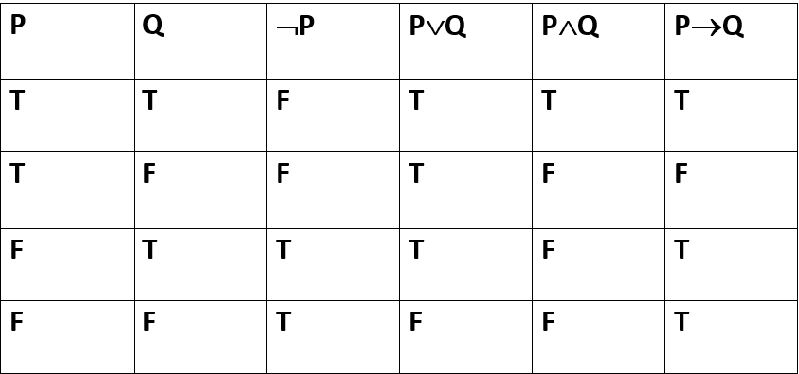
Propositional Calculus Semantics
An interpretation of a set of propositions is the assignment of truth value either T or F to each propositional symbol
T: true F: false

Slide 10
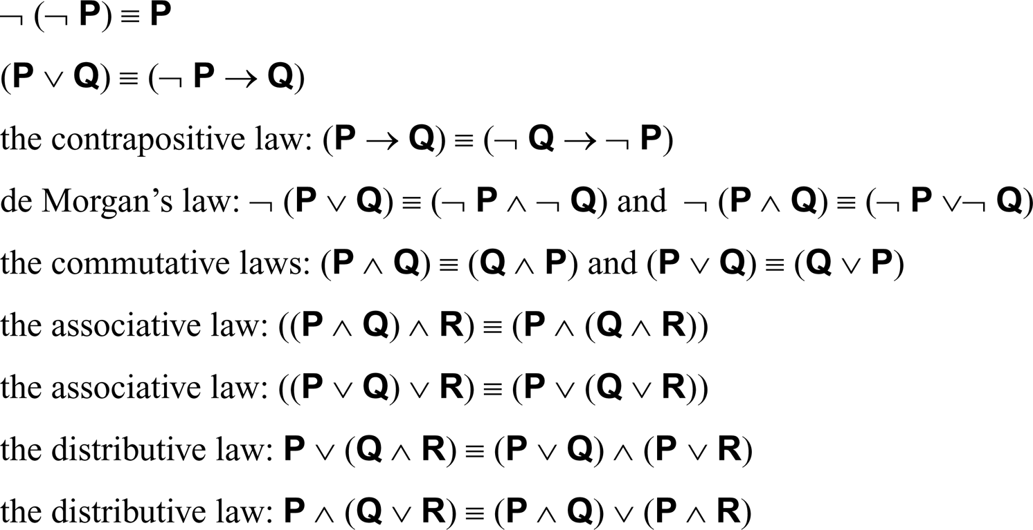
For propositional expressions P, Q, and R

Slide 11
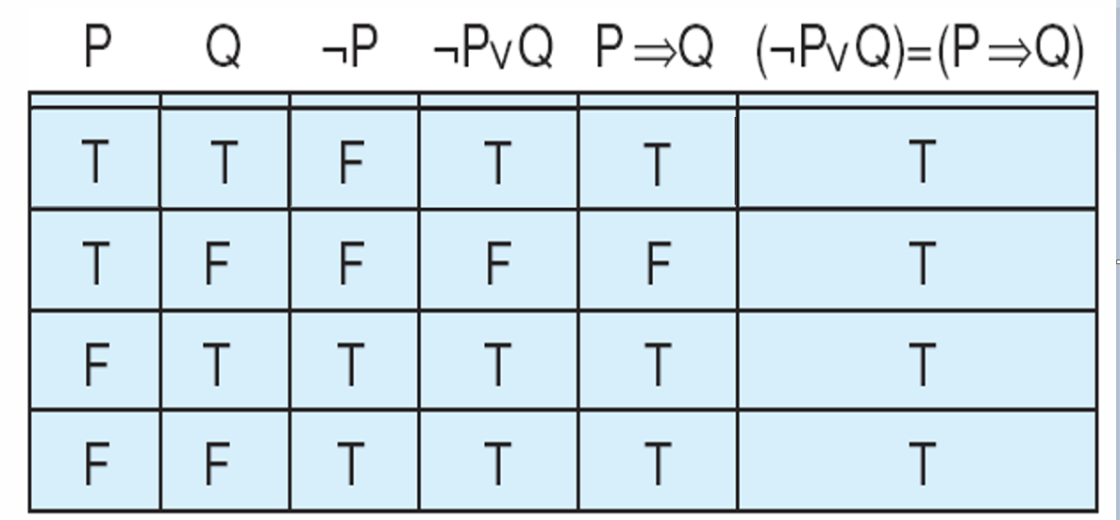
Truth table demonstrating the equivalence of ¬P∨Q and P→Q.
Luger: Artificial Intelligence, 6th edition. © Pearson Education Limited, 2009

Slide 12
The Predicate Calculus

Slide 13


Predicate Calculus
In propositional calculus, each atomic denotes a single proposition.
access the components of an individual assertion.
Predicate calculus provides this ability.
Ex:
WEATHER
Propositional P: it rained on Saturday
Predicate weather(saturday, rain)

Slide 14

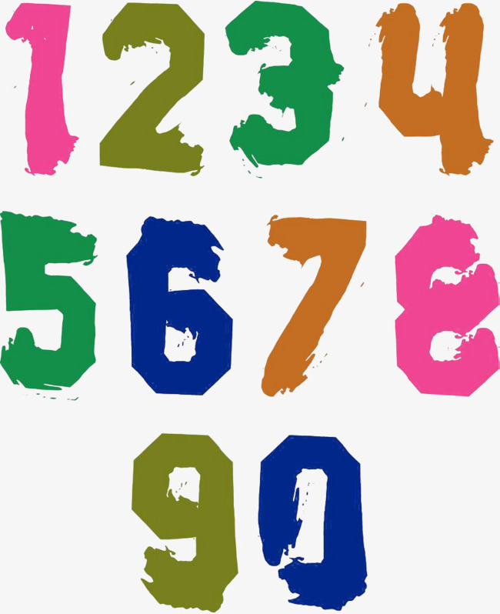

Predicate Calculus Symbol
The symbols of the predicate calculus consists of:
The set of letters
The set of digits
The underscore
Note: Begin with a letter

Slide 15

EXAMPLE: legitimate predicate calculus
student
tuition_fee
a3building
fail_F1NAL
IU
monapquantai_honemlancuoi
chaytheoconcho_tuongdolaem
b0y_h0bAo_dAjNa0_mAmNoN
anhthechiyeuem_va_motvainguoinua
anhxinloi_lolamemcobau

Slide 16

EXAMPLE: not legal
3customer
no blanks allowed
( ͡° ͜ʖ ͡°)
(。・ω・。)
passmonA+
( ◕‿◕✿)
duckyou!!!
ᕕ( ᐛ )ᕗ
ʕ •ᴥ•ʔゝ☆
23.255VND

Slide 17
Symbols and Terms
Truth symbols true and false
Constant symbols are symbol expressions having the first character lowercase
E.g: cashier, Monday…
Variable symbols are symbol expressions beginning with an uppercase character
E.g: A, B, C, X, Y, Z…

Slide 18
Symbols and Terms (cont’d)
Function symbols are symbol expressions having the first character lowercase
E.g: maxof
A function expression consists of a function constant of arity n, followed by n terms t1,t2… enclosed in parentheses and separated by commas
E.g: maxof(3,4)
A term is either a constant, variable, or function expression
E.g: maxof(maxof(3,4), 5)
*Arity: number of elements in the domain

Slide 19
Predicate and Atomic Sentences
Predicate symbols are symbols beginning with a lowercase letter. Predicates are special functions with true/false as the range.
An atomic sentence is a predicate constant of arity n, followed by n terms, t₁ ,t₂ ,…, t_{n,} enclosed in parentheses and separated by commas. The truth values, true and false, are also atomic sentences.
*Arity: number of arguments
love(you,me)
Predicate term(constant)
symbol

Slide 20
Predicate Calculus Sentences
Every atomic sentence is a sentence.
1. If s is a sentence, then so is its negation, ¬s.
If s₁ and s₂ are sentences, then so is their
2. Conjunction, s₁ ∧ s₂ .
3. Disjunction, s₁ ∨ s₂ .
4. Implication, s₁ → s₂ .
5. Equivalence, s₁ ≡ s₂ .
If X is a variable and s is a sentence, then
6. ∀X s is a sentence
7. ∃X s is a sentence

Slide 21
example
Let times and plus be function symbols of arity 2 and let equal and foo be predicate symbols with arity 2 and 3, respectively.
plus(two,three) is a function
equal(plus(two,three), five) is an atomic sentence.
equal(plus(2, 3), seven) is an atomic sentence.
∃ X foo(X,two,plus(two,three)) ∧ equal(plus(two,three),five) is a sentence
(foo(two,two,plus(two,three))) → (equal(plus(three,two),five) ≡ true) is a sentence

Slide 22
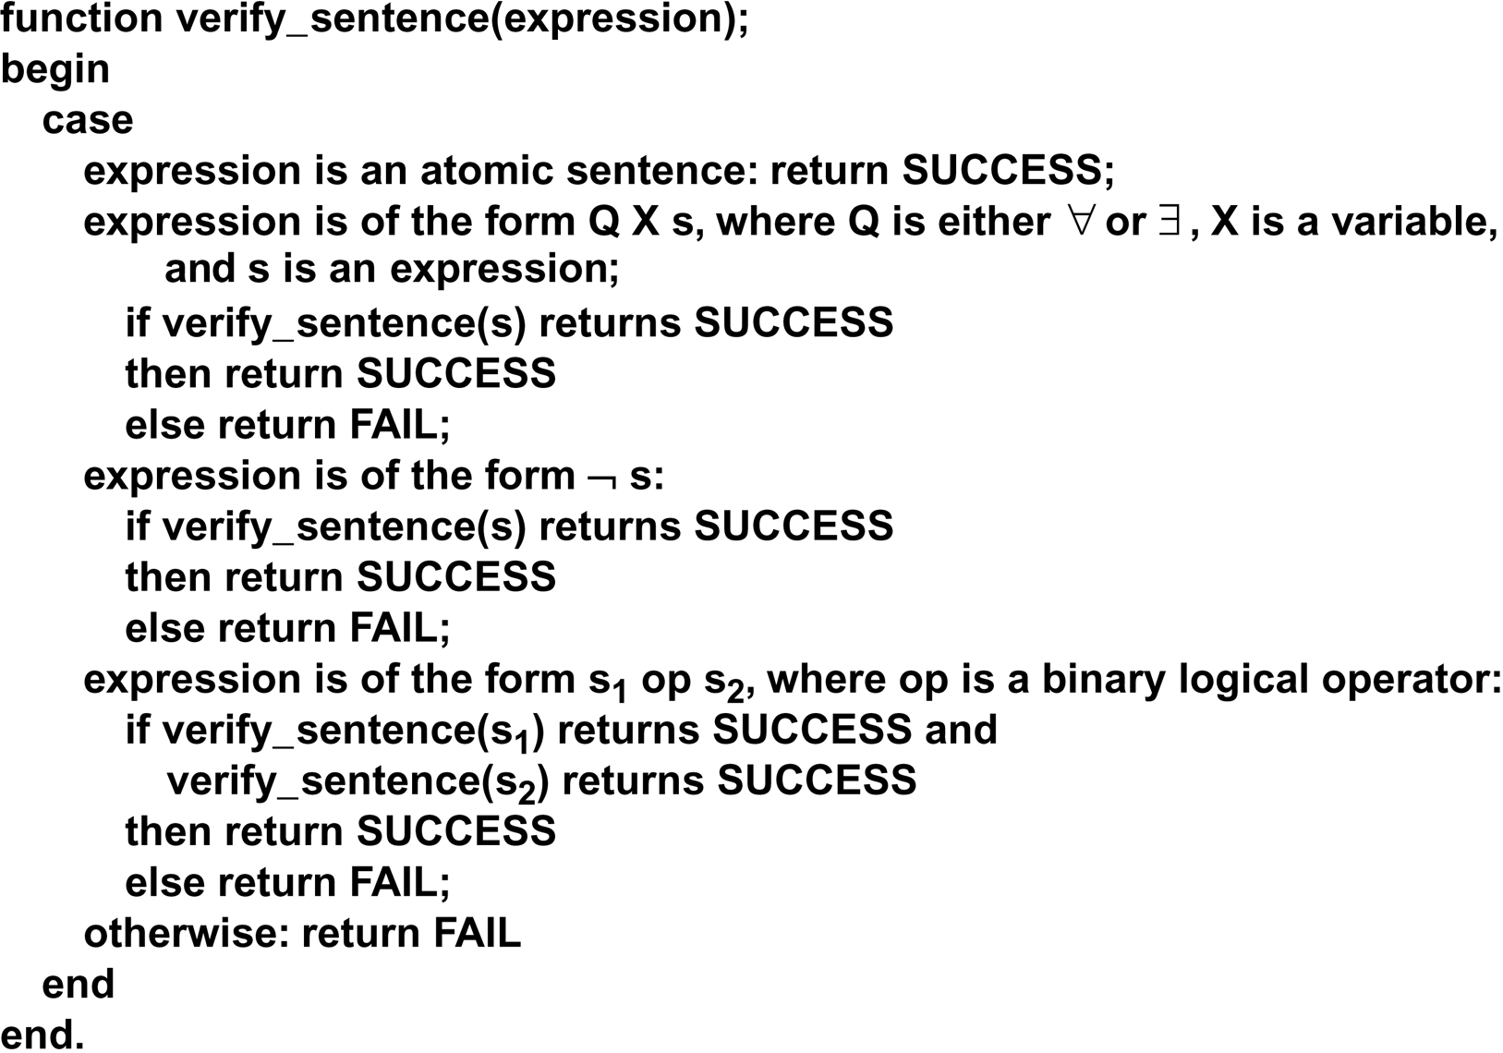
Verify sentence algorithm
Luger: Artificial Intelligence, 6th edition. © Pearson Education Limited, 2009

Slide 23
A Semantics for the Predicate Calculus
Having defined well-formed expressions in the predicate calculus
Important to determine the meaning in terms of objects, properties, and relations in the world
Provide a formal basis for determining the truth value of well-formed expressions.
The truth of expressions depends on the mapping of constants variables, predicates, and functions into objects and relations in the domain of discourse
The truth of relationships in the domain determines the truth of the corresponding expressions

Slide 24





Example
friends(batman,superman) T
friends(batman,joker) F
superman
batman
joker

Slide 25
Interpretation
Let the domain D be a nonempty set.
An interpretation over D is an assignment of the entities of D to each of the constant, variable, predicate, and function symbols of a predicate calculus expression:
1. Each constant is assigned an element of D.
2. Each variable is assigned to a nonempty subset of D (allowable substitutions).
3. Each function f of arity m is defined (D^{m} to D).
4. Each predicate of arity n is defined (D^{n} to {T,F}).

Slide 26
the truth value of predicate calculus expressions
Assume an expression E and an interpretation I over E over a nonempty domain D. The truth value for E is determined by:
1. The value of a constant is the element of D it is assigned to by I.
2. The value of a variable is the set of elements of D it is assigned to by I.
3. The value of a function expression is that element of D obtained by evaluating the function for the parameter values assigned by the interpretation.

Slide 27
the truth value of predicate calculus expressions
4. The value of the truth symbol “true” is T, and “false” is F.
5. The value of an atomic sentence is either T or F, as determined by the interpretation I.
6. The value of the negation of a sentence is T if the value of the sentence is F, and F if the value of the sentence is T.
7. The value of the conjunction of two sentences is T, if the value of both sentences is T and F otherwise.
8-10. The truth value of expressions using ∨,→, and ≡ is determined as defined in Section 2.1.2.

Slide 28
the truth value of predicate calculus expressions
Finally, for a variable X and a sentence S containing X:
11. The value of ∀X S is T if S is T for all assignments to X under I, and it is F otherwise.
12. The value of ∃X S is T if there is an assignment to X under I such that S is T, and it is F otherwise

Slide 29
example
¬ ∃ X p(X) ≡ ∀ X ¬ p(X)
¬ ∀ X p(X) ≡ ∃ X ¬ p(X)
∃ X p(X) ≡ ∃ Y p(Y)
∀ X q(X) ≡ ∀ Y q(Y)
∀ X (p(X) ∧ q(X)) ≡ ∀ X p(X) ∧ ∀ Y q(Y)
∃ X (p(X) ∨ q(X)) ≡ ∃ X p(X) ∨ ∃ Y q(Y)

Slide 30
First-order predicate calculus
First-order predicate calculus allows quantified variables to refer to objects in the domain of discourse and not to predicates or functions.
John likes to eat everything.
∀X food(X) → likes (john,X)
John likes at least one dish Jane likes.
∃Y food(X) ∧ likes (jane, X) → likes (john, X)

Slide 31
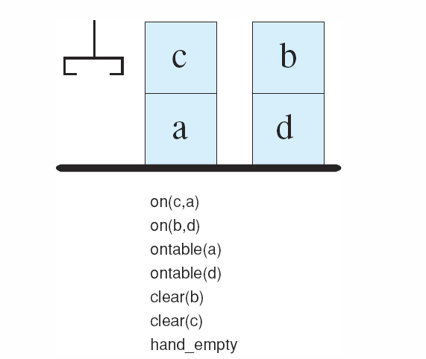
First-order predicate calculus
Figure 2.3: A blocks world with its predicate calculate description.
Luger: Artificial Intelligence, 6th edition. © Pearson Education Limited, 2009

Slide 32
Blocks world example
∀X(¬∃ Y on(Y,X)→clear(X))
That is, for all X, X is clear if there does not exist a Y such that Y is on X

Slide 33
Using Inference Rules to Produce Predicate Calculus Expressions

Slide 34
Satisfy, model, valid, inconsistent
For a predicate calculus expression X and an interpretation I:
If X has a value of T under I and a particular variable assignment, then I is said to satisfy X.
If I satisfies X for all variable assignments, then I is a model of X.
X is satisfiable iff there is an interpretation and variable assignment that satisfy it; otherwise it is unsatisfiable.

Slide 35
Satisfy, model, valid, inconsistent
A set of expressions is satisfiable iff there is an interpretation and variable assignment that satisfy every element.
If a set of expressions is not satisfiable, it is said to be inconsistent.
If X has a value T for all possible interpretations, X is said to be valid.

Slide 36
Proof procedure
A proof procedure is a combination of an inference rule and an algorithm for applying that rule to a set of logical expressions to generate new sentences.
(Proof by resolution inference rule is described in Chapter 11.)

Slide 37
Logically follows, sound, and complete
A predicate calculus expression X logically follows from a set S of predicate calculus expressions if every interpretation and variable assignment that satisfies S also satisfies X.
An inference rule is sound if every predicate calculus expression produced by the rule from a set S of predicate calculus expressions also logically follows from S.
An inference rule is complete if, given a set S of predicate calculus expressions, the rule can infer every expression that logically follows from S.

Slide 38
Modus ponens and modus tollens
If the sentences P and P → Q are known to be true, then modus ponens lets us infer Q.
If the sentence P → Q is known to be true, and the sentence Q is known to be false, modus tollens lets us infer ¬P.

Slide 39
And elimination / and introduction
And elimination lets us infer the truth of either of the conjuncts from the truth of a conjunctive sentence. For instance, P ∧ Q lets us conclude both P and Q are true.
And introduction allows us to infer the truth of a conjunction from the truth of its conjuncts. For instance, if P and Q are true, then P ∧ Q is true.

Slide 40
Universal instantiation
Universal instantiation states that if any universally quantified variable in a true sentence is replaced by any appropriate term from the domain, the result is a true sentence. Thus, if a is from the domain of X, ∀ X P(X) lets us infer a.

Slide 41
Most general unifier (mgu)
If s is any unifier of expressions E and g is the most general unifier of that set of expressions, then for s applied to E there exists another unifier s’ such that Es = Egs’, where Es and Egs’ are the composition of unifiers applied to the expression E.
Basic idea: Commit to a substitution only if you have to; keep it as general as possible.

Slide 42
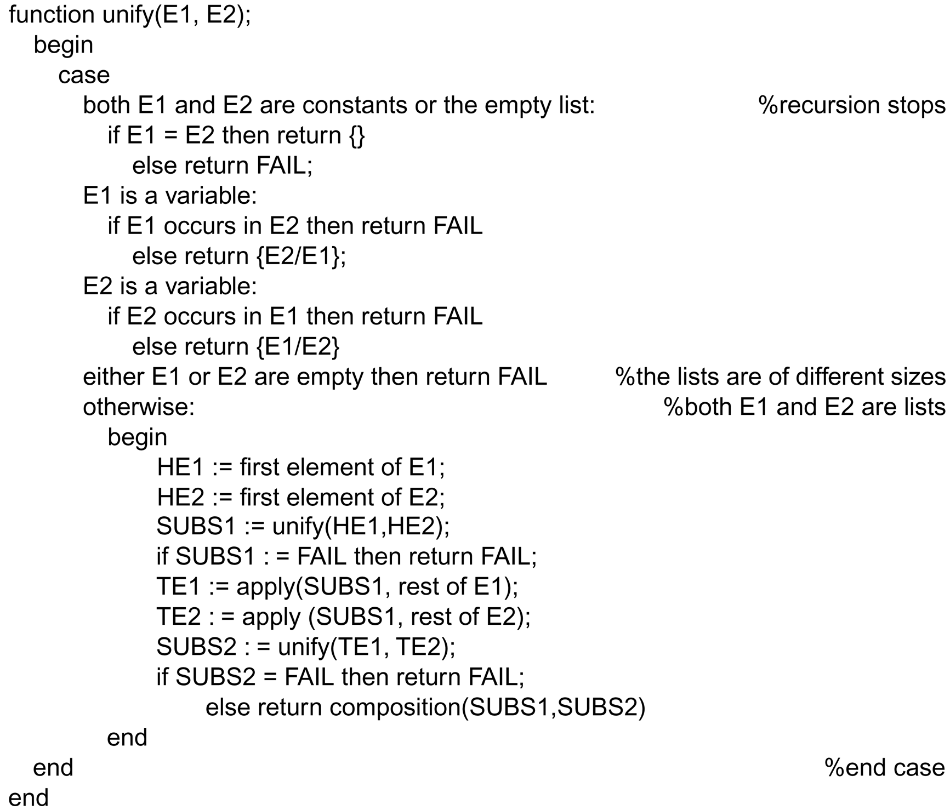
Luger: Artificial Intelligence, 6th edition. © Pearson Education Limited, 2009

Slide 43
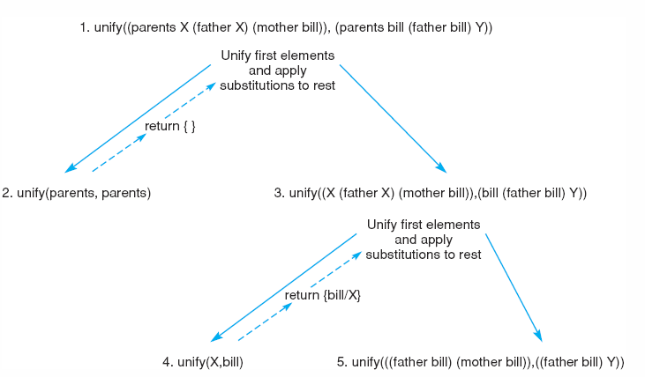
Figure 2.5: Further steps in the unification of (parents X (father X) (mother bill)) and (parents bill (father bill) Y).
Luger: Artificial Intelligence, 6th edition. © Pearson Education Limited, 2009

Slide 44
Figure 2.5: Further steps in the unification of (parents X (father X) (mother bill)) and (parents bill (father bill) Y).
Luger: Artificial Intelligence, 6th edition. © Pearson Education Limited, 2009

Slide 45
Processed example
parents X (father X) (mother bill)), (parents bill (father bill) Y)
parents =? Parents yes
return nil
(X (father X) (mother bill)), (bill (father bill) Y)
X =? bill no, substitute
return {bill/X}
(bill (father bill) (mother bill)), (bill (father bill) Y)
bill =? bill yes
return nil

Slide 46
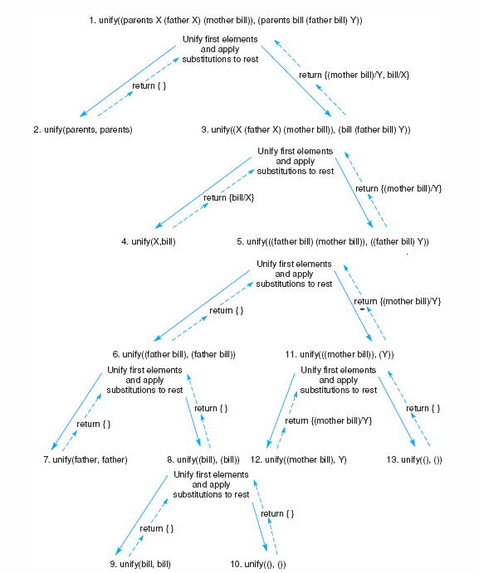

Slide 47
Processed example (cont’d)
( (father bill) (mother bill)), ( (father bill) Y)
bill =? bill yes
return nil
(father bill), (father bill)
father =? father yes
return nil
(bill) (bill)
bill =? bill yes
return nil

Slide 48
Processed example (cont’d)
(mother bill), Y
(mother bill) =? Y no, substitute
return {(mother bill) / Y}
The set of unifying substitutions for
(parents X (father X) (mother bill)), (parents bill (father bill) Y)
is
{bill / X, (mother bill) / Y}.
The result is
(parents bill (father bill) (mother bill))

Slide 49
Application: A Logic-Based Financial Advisor

Slide 50

The function is to advise a user about whether to invest in stocks or savings. Some investors might want to split their money. Let's say that we have determined the
following rules:

Slide 51



1. Individuals with inadequate savings should make increasing savings their top priority,
regardless of income.
2. Individuals with adequate savings and adequate income should consider stocks,
which are riskier but potentially more profit.
3. Individuals with a lower income and already have adequate savings should split their
income between savings and stocks.

Slide 52
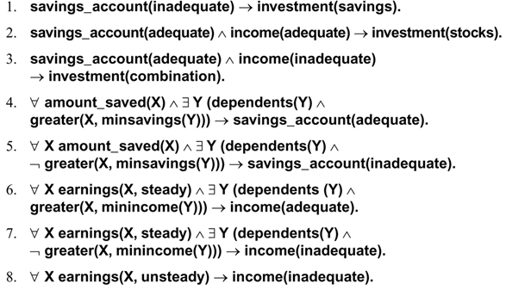
Luger: Artificial Intelligence, 6th edition. © Pearson Education Limited, 2009

Slide 53


Herman makes only $25000 a year. However he had the good fortune of inheriting some money and has $22000 saved. He has three dependents.
Our rule is to have at least $5000 in the bank for each dependent. An adequate income
must be steady and supply at least $15000 per year plus $4000 for each dependent

Slide 54



Let's try to infer an investment strategy for Herman. We can use forward chaining
X=25000 ; Y=220000 ; minincome(Y)=15000+Y*4000 ; minsavings(Y)=5000*Y

Slide 55

1.We have:
amount_saved(22000)
earnings(25000, steady)
dependents(3)
Evaluating the function : minincome(3) yields 15000+3*4000= 27000. So
¬ greater(25000,27000)) is true, and via Modus Ponens we can now infer the RHS of rule 7:
∀x Earnings(25000, steady) ^ ∃y (dependents(3) ^ ¬greater(25000, minIncome(3)))→ income(inadequate).

Slide 56

2.We also have:
amount_saved(22000)
dependents(3)
Evaluating the function minisavings(3) =5000*3 = 15000.
We have Greater(22000,15000) is true so via Modus Ponens we can now infer the RHS of #4:
∀x amount_saved(22000) ^ ∃y (dependents(3) ^ greater(x,minisavings(3))) → savings_account(adequate).
3.Finally, we use rule 3 : savings_account(adequate) ^ income(inadequate) → investment(combination).

Slide 57
Summary and References

Slide 58
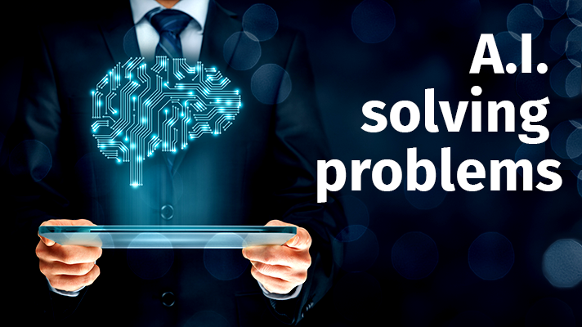
summary
1. The predicate calculus is the presentation language for AI problems solving
2.The symbols, terms, expressions, and semantics of the language were described and defined A given set of expression can constitute a sentences logically based on the inference rules defined by the semantics of predicate calculus

Slide 59

We defined a unification algorithm that determines the variable substitutions that make two expressions match, which is essential for the application of inference rules.
Example of a financial advisor is an application present financial knowledge with the predicate calculus and demonstrates logical inference as a problem-solving technique.

Slide 60

References
Robert Wilensky’s CS188 slides
(George F Luger) ARTIFICIAL INTELLIGENCE 6th edition: 45-77.
Slides from Nilufer Onder (Michigan Tech)

Slide 61
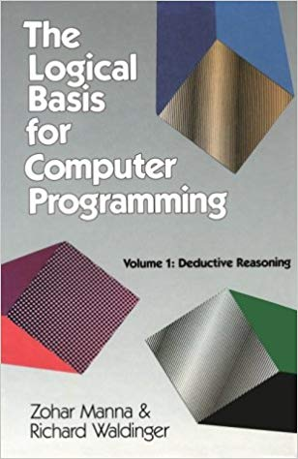
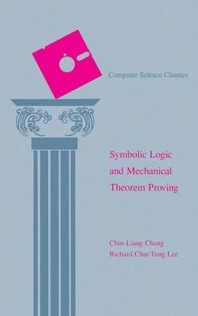
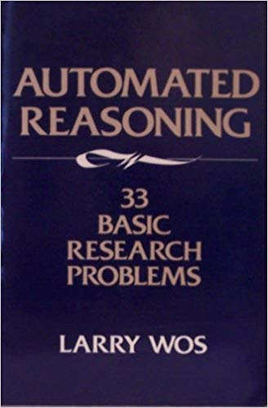
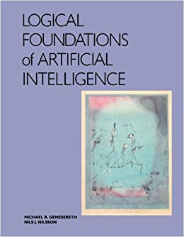
The Logical Basis for Computer Programming by Zohar Manna and Richard
Waldinger (1985)
Symbolic Logic
and Mechanical Theorem Proving by Chin-liang Chang and Richard Char-tung Lee
(1973)
Automated Reasoning: 33 Basic Research Problems by Larry Wos (1987)
Logical Foundations of Artificial Intelligence by Michael
Genesereth and Nils Nilsson (1987)

Slide 62
THANKS For listening!
Any questions?
Notes:
Theme Source: Quickly - SildesCarnival

